Slide 1
Geospatial analysis in R: Part 2
Michael Otterstatter BCCDC Biostats Session
Sept 13, 2019

Slide 2
Session overview
Background and concepts
principles of data visualisation
review of map types
Creating basic maps in R
tmap

Slide 3
Background and concepts

Slide 4
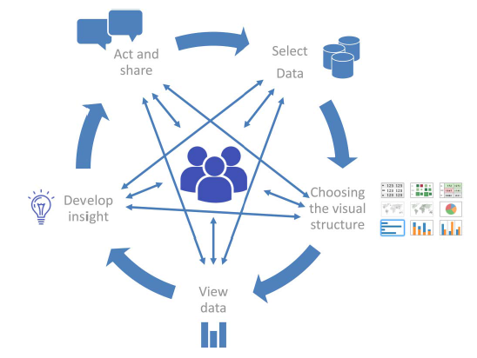
Principals of data visualization
Background and concepts
Data visualisation is
A well-known component of scientific communication, but is increasingly recognized as a process unto itself for generating insights; and,
a rapidly growing field, particularly with availability of large complex datasets and powerful viz tools
‘The visual analytics cycle’, Martinez et al. 2016

Slide 5
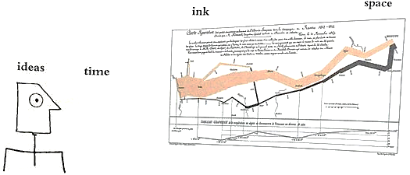
Principals of data visualization
Background and concepts
Consider a guiding principle in visualization…
“Graphical excellence gives the viewer the greatest number of ideas in the shortest time with the least ink in the smallest space…and requires telling the truth about the data”*
*Tufte, 2001.

Slide 6
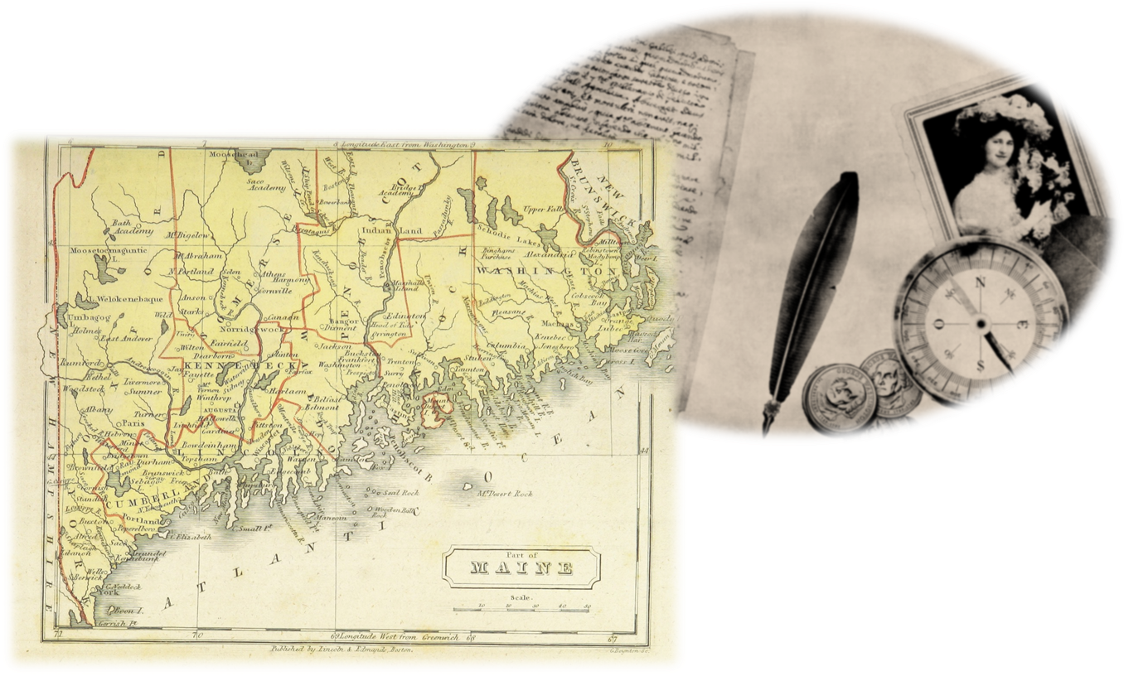
Principals of data visualization
Background and concepts
…and a distinction, particular to maps, underscoring the need for accurate and effective map making:
“…maps differ from statistical graphics because the geographic setting portrayed in the map almost always triggers memories, opinions, and conclusions wholly separate from (but perhaps related to) the intent of the mapmaker”*
*Waller & Gotway, 2004.

Slide 7
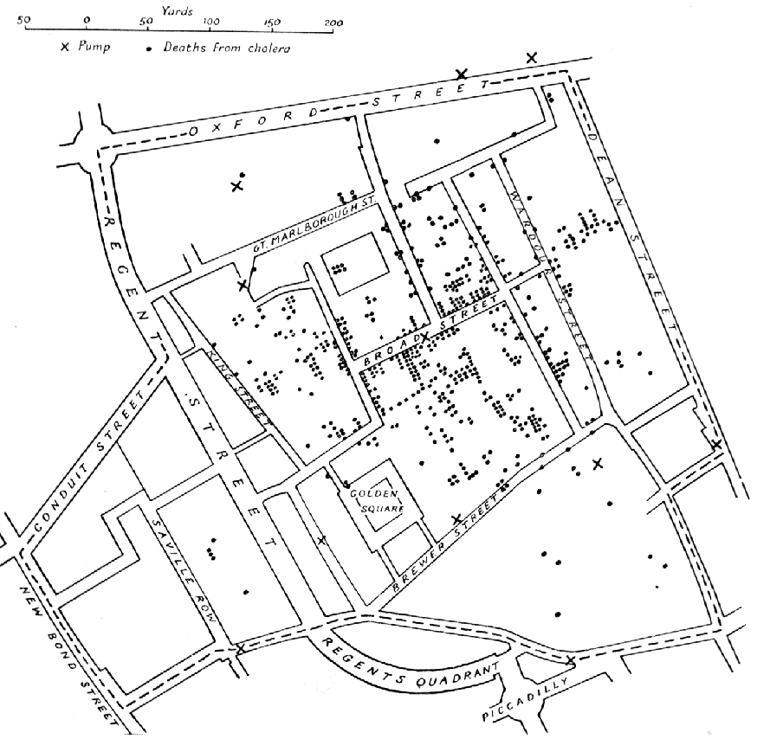
Review of map types
Background and concepts
Point features vs aggregate features
Point maps represent specific geographic locations as dots (points) on the map, e.g., residence or facility, and are primarily used to show spatial distribution
A famous public health example is John Snow’s maps of cholera cases (represented as points) – today, we often still show spatial distributions using simple dots on a map

Slide 8
Review of map types
Background and concepts
Point features vs aggregate features
Point maps can reflect a limited amount of attribute information through the use of differing symbols, and/or colours, sizes and transparencies of the points
Hence, point maps are most suitable when there is no attribute information shown, or when the attributes take on a small number of discrete values

Slide 9
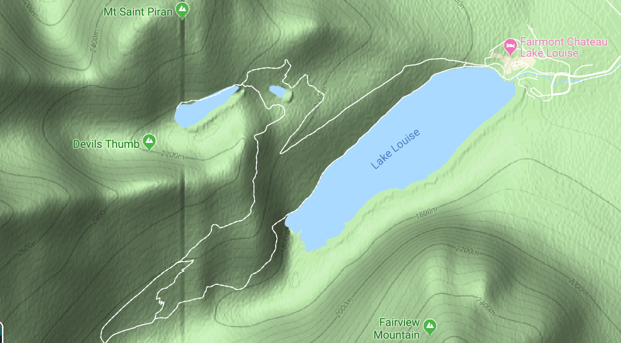
Review of map types
Background and concepts
Point features vs aggregate features
Contour maps are suitable when attribute information is a continuous range of values, e.g., topographic maps with isolines/shading to represent differing elevation

Slide 10
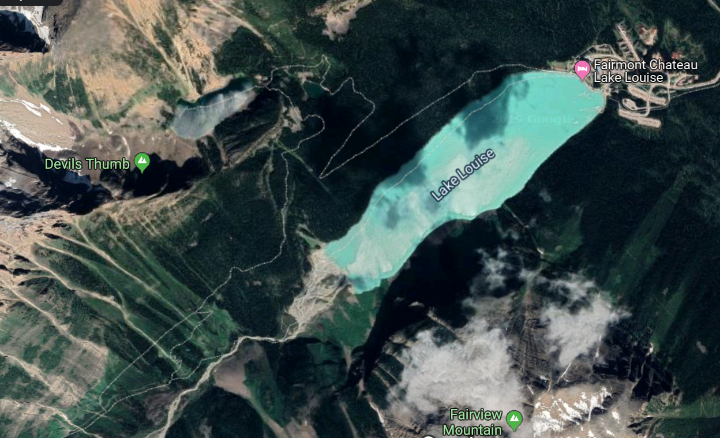
Review of map types
Background and concepts
Point features vs aggregate features
Image maps are based on pixels and variations in colour to show features, most notably aerial photographs and satellite imagery

Slide 11
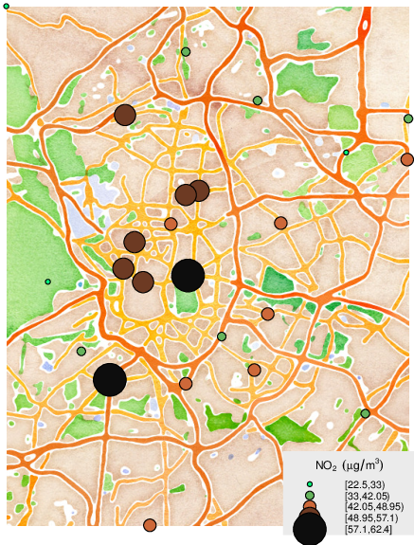
Review of map types
Background and concepts
Point features vs aggregate features
For areal data (areas and aggregations), maps use symbols, patterns or colour to represent attribute values for a region
For example, proportional symbol maps, use symbol size scaled proportionately to the value of an attribute for a given region
Lamigueiro, Ó. P. 2014

Slide 12
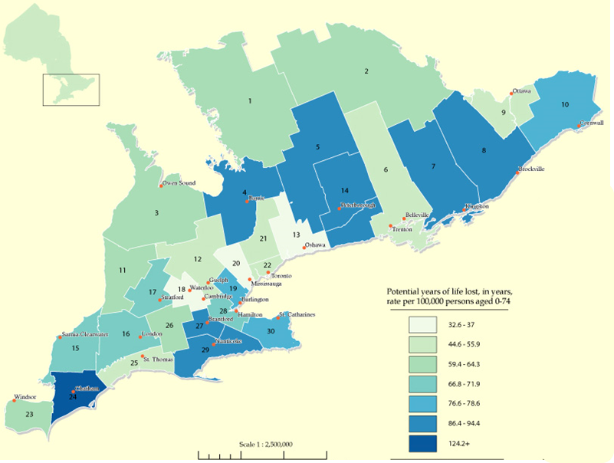
Review of map types
Background and concepts
Point features vs aggregate features
Choropleth maps display areal data by assigning colours to different attribute values and shading the regions of the map accordingly
Despite certain limitations (e.g., single colour implies constant regional rates), choropleth maps are common in public health given data are often available only as regional aggregates

Slide 13
Review of map types
Background and concepts
Point features vs aggregate features
Range of values shown in choropleth maps may be defined into classes (e.g., differing colours or patterns) of non-overlapping intervals in an attribute (‘classed choropleth maps’) or show a continuous change (e.g., differing hue or intensity of a single colour)

Slide 14

Review of map types
Background and concepts
So, which type of map to use? Consider:
Any working limitation or restrictions (e.g., only black and white)
appropriateness given the data at hand (point locations vs areal data)
In general, try a few different map types and see which best communicates the message in the data

Slide 15
Review of map types
Background and concepts
Reference maps vs thematic maps
Reference maps focus on locations and names of particular features, e.g., boundaries and names of standard geographic areas, and their major physical features, such as roads, coastlines, and bodies of water
Thematic maps focus on spatial variation in one or a few specific topics or ‘themes’ -- common types of thematic maps show distributions of population density or average income
* Also see: www150.statcan.gc.ca/n1/pub/92-195-x/92-195-x2011001-eng.htm4

Slide 16
Review of map types
Background and concepts
Reference maps vs thematic maps
Reference maps and thematic maps are not mutually exclusive: thematic maps typically contain some reference information, e.g., place names or roads, to help orient readers to the regions shown on the map

Slide 17
Review of map types
Background and concepts
Reference maps vs thematic maps
Thematic maps contain two key elements:
i) a base map and ii) statistical data
Both elements usually come from digital files, e.g., cartographic boundary files and census data
often thematic maps are point maps or choropleth maps
thematic maps have a variety of purposes, including presentation of geographic data and exploratory spatial data analysis

Slide 18

Considerations and cautions
Background and concepts
Aesthetics (i.e., those aspects or principles concerned with perceptual value or beauty) are not covered here, but can be essential for accurate and effective communication with maps

Slide 19
Creating basic maps in R

Slide 20
Background
Creating basic maps in R
Maps are one of the most fundamental and effective communication tools, and form the basis of geospatial analysis
Map making is now more accessible through powerful and user-friendly software, such as R
Although it is now easy to jump in and make maps, give careful attention to the accuracy and effectiveness of your maps as communication tools

Slide 21
Background
Creating basic maps in R
Here, we focus on the R package tmap for modern, flexible mapping. For information on tmap see
https://cran.r-project.org/web/packages/tmap/ and
https://cran.r-project.org/web/packages/tmap/vignettes/tmap-getstarted.html
The applications of tmap herein are based on Lovelace et al. https://geocompr.robinlovelace.net/adv-map.html

Slide 22
Background
Creating basic maps in R
Static maps
Base R function plot() accepts vector and raster data and produces static maps quickly and simply; however, it is often not flexible enough
R package tmap()is a set of tools for creating thematic maps from vector or raster data
maps can be static or interactive maps
Syntax is concise, easy to learn, and works well with essential data manipulation tools in tidyverse

Slide 23
tmap
Creating basic maps in R
like the primary plotting package in R (ggplot2), tmap is based on the principles of layer grammar of graphics (Wilkinson, 2012)
Essentially tmap generates maps from a spatial dataset by forming one or more layers that each associate specific visual characteristics of map elements (‘aesthetics’, such as position, colour, size, transparency, etc.) with data variables

Slide 24
tmap
Creating basic maps in R
To create a map, one uses the tm_shape() function plus (+)
one or more aesthetic layers, e.g., tm_polygon, tm_fill, tm_symbol, etc.
tm_shape(my_sf_data) +
tm_polygon(col = “my_regions”)
tm_shape() specifies the sf spatial data object, whereas the layers specify how data variables are assigned to visual map elements (aesthetics).

Slide 25
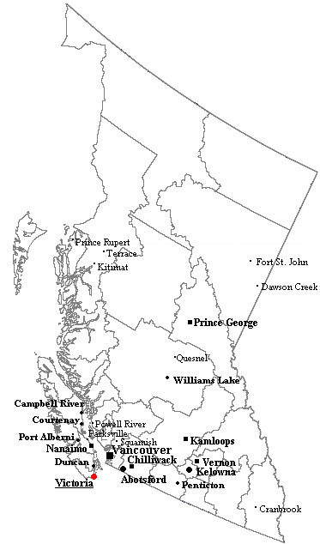
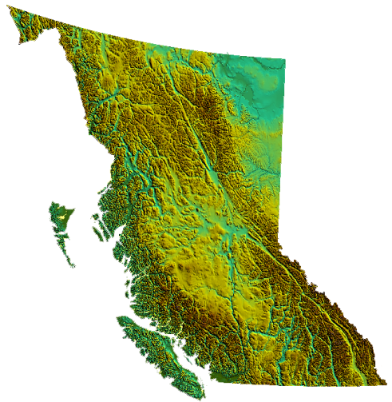
dataset_a
Layer A [aesthetics: borders]
Layer B [aesthetics: point locations]
tm_shape(dataset_a) + tm_polygons() + tm_symbols()
dataset_b
Layer C [aesthetics: geography]
tm_shape(dataset_b) + tm_fill()

Slide 26
tmap
Creating basic maps in R
To see a list of the aesthetic layers that are available in tmap, type help(“tmap-element”)
In order to generate a quick and simply thematic map, one can also use qtm(my_sf_data)

Slide 27
tmap
Creating basic maps in R
In R, we typically assign data, variables, plots and all other things as ‘objects’. Similarly, working with and saving maps is made easier by creating them as objects
my_base_map <- tm_shape(my_sf_data) + tm_polygon() (e.g., starting with borders)

Slide 28
tmap
Creating basic maps in R
New layers can then be added successively:
new_map1 <- my_base_map +
tm_shape(more_sf_data) +
tm_raster() (e.g., adding elevation)
new_map2 <- new_map1 +
tm_shape(even_more_sf_data) +
tm_lines() (e.g., adding bodies of water)

Slide 29
tmap
Creating basic maps in R
Note that tmap() automatically uses certain default aesthetics (e.g., black lines, grey shading for fills, etc.), but that these are all modifiable in their associated layer.
There are two types of aesthetics: i) static aesthetics – set visual aspect of map element to a constant value; ii) variable aesthetics – set visual aspects to vary according to values in the dataset
tm_shape(my_sf_data) +
tm_fill(col = “red”)
tm_shape(my_sf_data) +
tm_fill(col = “my_landarea_variable”)

Slide 30
tmap
Creating basic maps in R
Aesthetics include elements such as colour (col =), transparency (alpha =), line width (lwd =), line type (lty =), title (title =), etc.

